Slide 1
The Trust Landscape – Impressions from Young Professionals
Young trust professionals share their impressions of the trust industry – what they have learned and what they are still seeking
William Warren, Senior Vice President, U.S. Trust Company of Delaware
Cody Snyder, Senior Trust Counsel, Commonwealth Trust Company
Emily Villacis, UNIVERSITY OF DELAWARE, TRUST MANAGEMENT STUDENT
Harrison R. Gelber, SVP, Chief Compliance & Administrative Officer, WSFS Wealth

Slide 2
Introduction

Slide 3
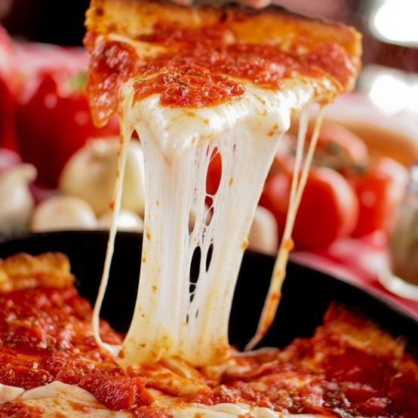
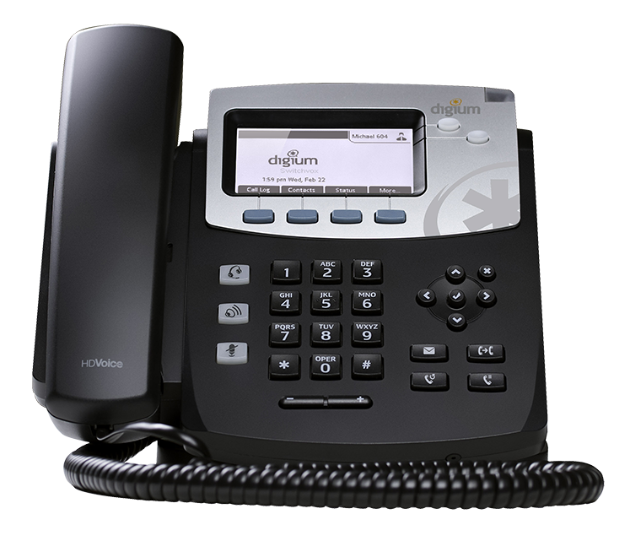
First Jobs

Slide 4
What made you initially interested in this industry, and what keeps you excited?

Slide 5
A day in the life…

Slide 6
What have you learned thus far?

Slide 7
What has surprised you?

Slide 8
What are you still seeking?

Slide 9
What is your outlook for the future?

Slide 10
What is your outlook for the future?
Cannabis Industry
Global legal marijuana market size was estimated at USD 13.8 B in 2018 and is projected to expand at a CAGR of 23.9% by 2025
Spending on legal cannabis expected to hit USD 57 B by 2027 with the largest group
North America at USD 47.3 B
Outside North America expected to grow from USD 52 M in 2017 to USD 2.5 B in 2027

Slide 11
Sources:
Legal Marijuana Market Size, Share & Trends Analysis Report By Type (Medical Cannabis, Recreational Cannabis), By Product Type, By Medical Application (Cancer, Mental Disorders), And Segment Forecasts, 2019 – 2025. Grand View Research, Market Research Report. May, 2019.
Legal Cannabis Industry Poised For Big Growth, In North America And Around The World. Pellechia, Thomas, Forbes. March 1, 2018.

Slide 12
What is your outlook for the future?
Cryptocurrencies
Global market estimated valuation at USD 856.36 B in 2018 with a CAGR of 11.9% during 2019-2024
Source:
Global Cryptocurrency Market Growth , Leading Players and Forecast To 2024. Market Watch. September 20, 2019.

Slide 13
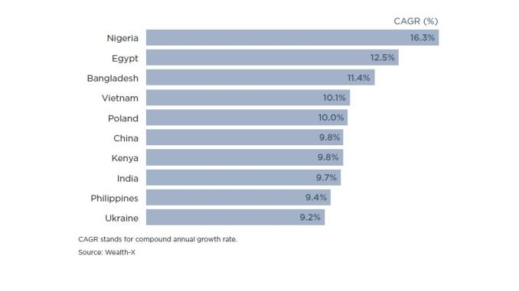
What is your outlook for the future?
10 fastest growing high net worth countries:

Slide 14
What is your outlook for the future?
Record number of young billionaires
Of the 2,153 billionaires on Forbes’ 2019 List, a record 71 members are under age 40
21 newcomers from 18 countries
Over half are “self-made”
Source:
The World’s Youngest Billionaires In 2019: Meet The 71 Under Age 40. Chaykowski, Kathleen, Forbes. March 5, 2019.

Slide 15
How would you compare your career path with that of your peers not in this industry?

Slide 16
Ways to attract/retain new talent

Slide 17
Questions?

